Slide 1
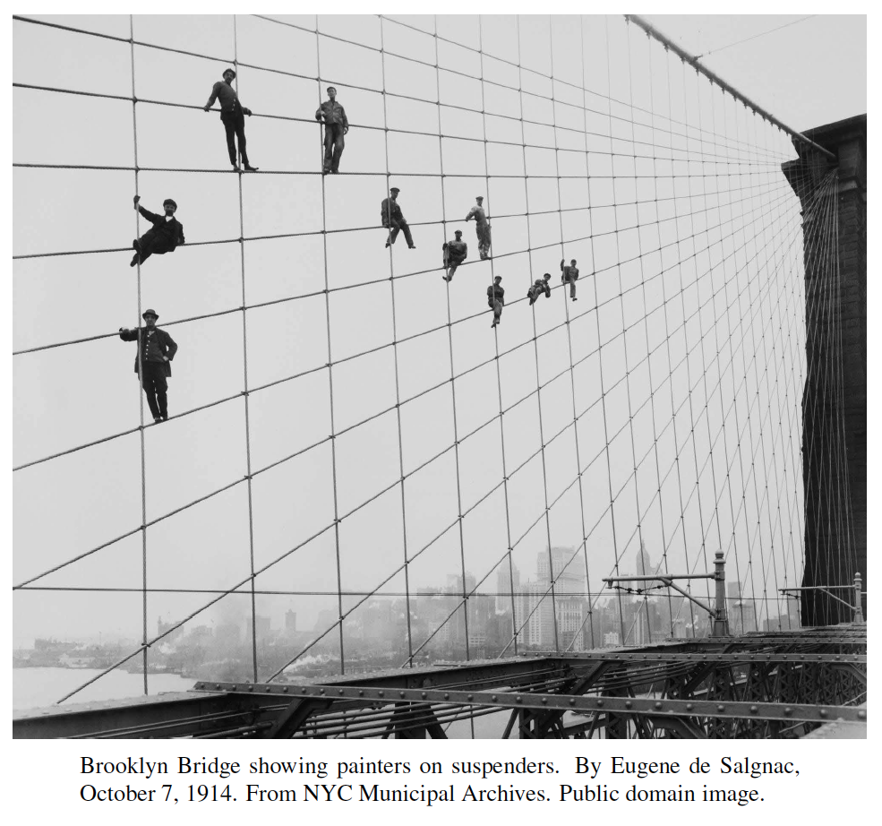
Linear Programming
Presentation for use with the textbook, Algorithm Design and Applications, by M. T. Goodrich and R. Tamassia, Wiley, 2015

Slide 2
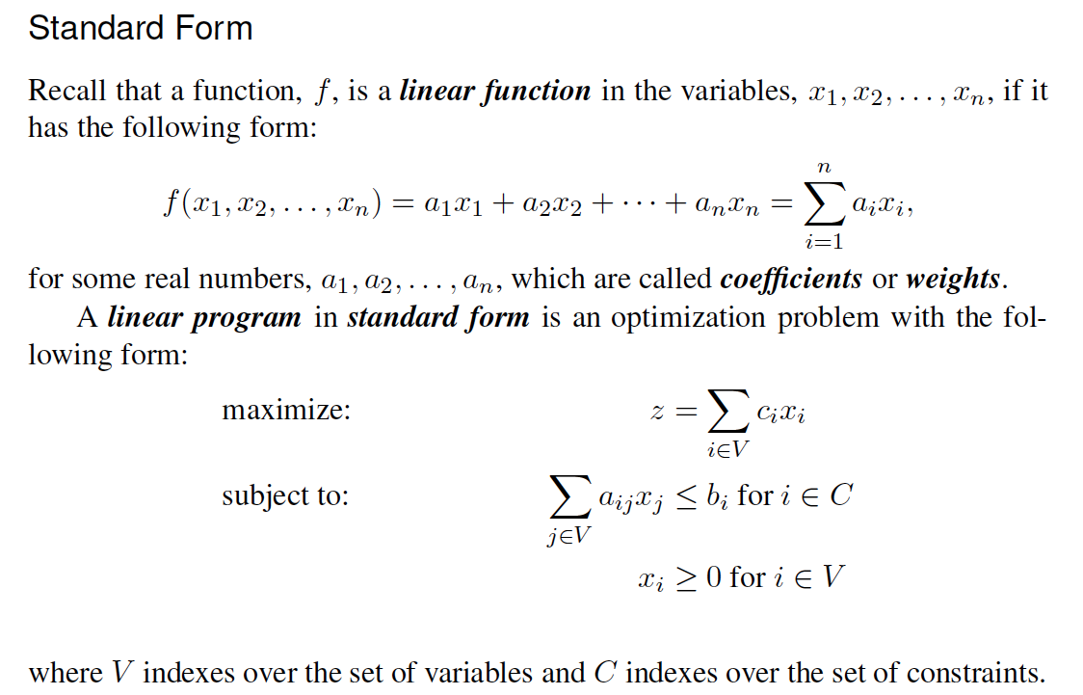
Formulating the Problem
The function to maximize is called the objective function and the inequalities are called constraints.

Slide 3
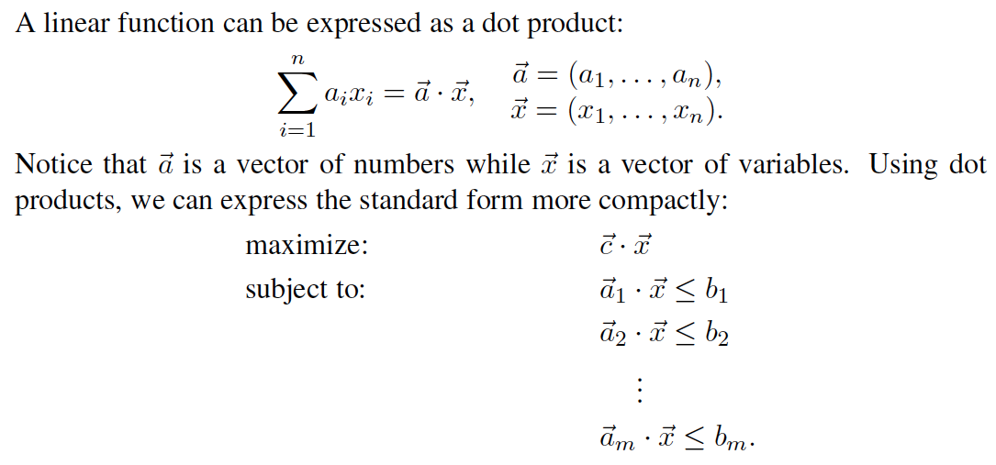
Matrix Notation

Slide 4
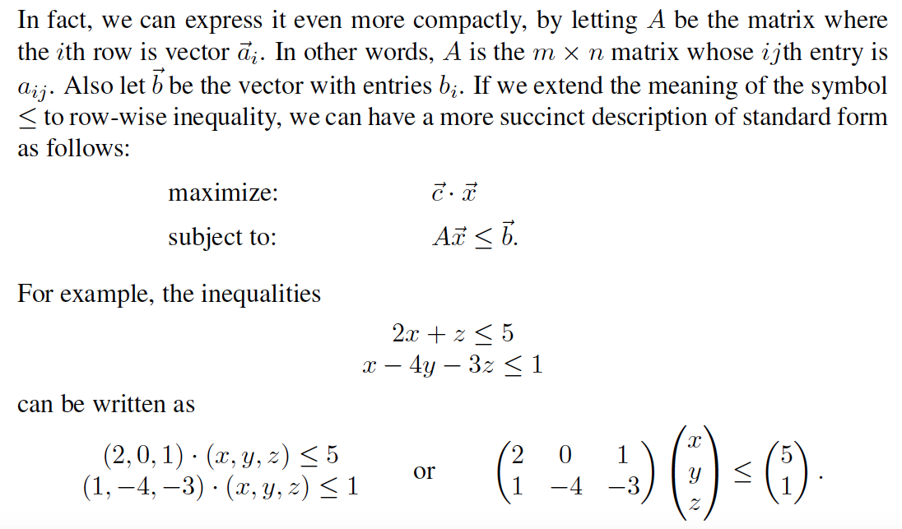
Compact Matrix Notation

Slide 5
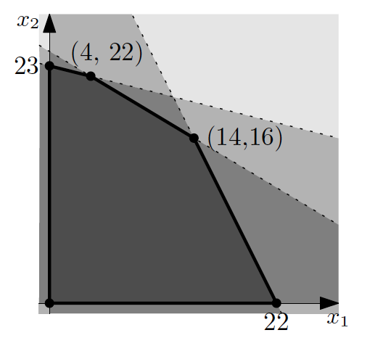
Geometry of Linear Programs
Let us restrict ourselves to the two-dimensional case:
Each inequality constraint describes a half-plane, expressed as an infinite region to one side of a line.
So a point that is inside all of these half-planes is a point that satisfies all the constraints.
We call such a point a feasible solution.
Intersections of half-planes have the shape of a convex polygon (Section 22.2).
We call this set the feasible region.

Slide 6
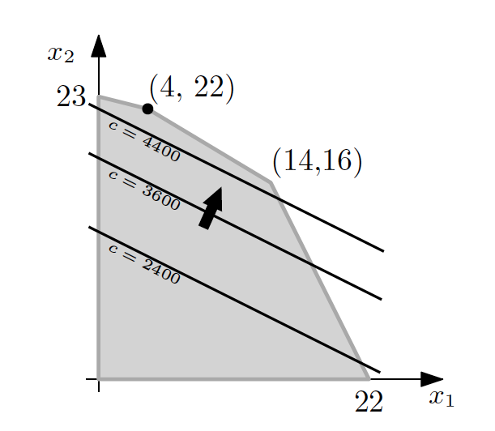
Optimization
We are interested in a feasible solution that optimizes the objective function. We refer to this feasible solution an optimal solution.
For example, consider the objective function
c = 1000x₁ + 2000x₂.
Applying this to previous 2-dimensional constraints, optimization looks like a moving line that intersects the feasible region.

Slide 7
The Simplex Method
To solve a linear program using the simplex method, we must first rewrite the problem in a format known as slack form.
To convert a linear program from standard form into slack form, we rewrite each of the inequality constraints as an equivalent equality constraint.
This is done with the introduction of new variables, called slack variables, which are nonnegative and measure the difference in the original inequality.

Slide 8
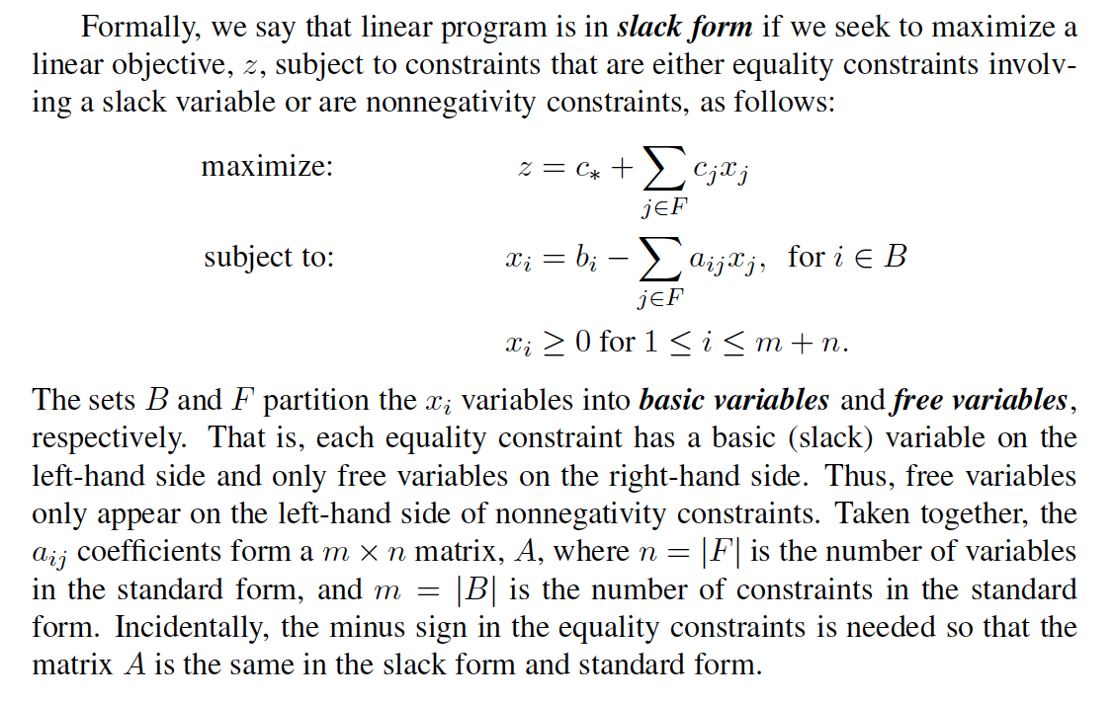
Slack Form

Slide 9
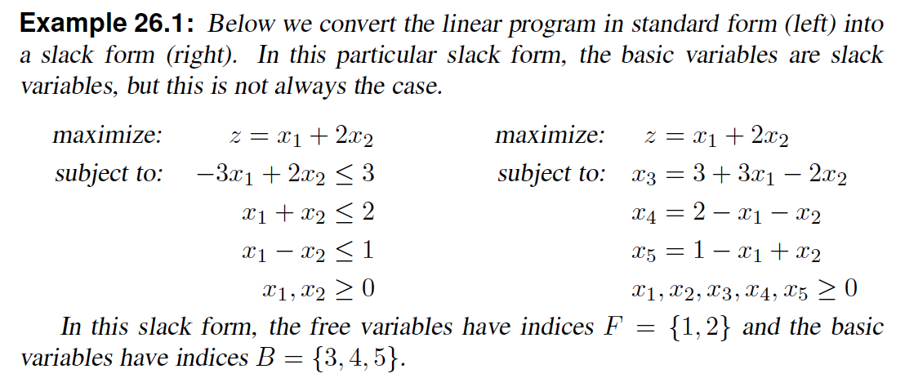
Example

Slide 10
Basic Solutions and Pivots
We are interested in the basic solution of the slack form, which means we set all the free variables to zero and let the equality constraints determine the values of the basic variables.
The simplex method works by rewriting the slack form until a basic solution becomes an optimal solution.
The operation we use to rewrite the slack form is called a pivot, which takes a free variable and a basic variable and interchanges their roles by rewriting the equality constraints and objective function.

Slide 11
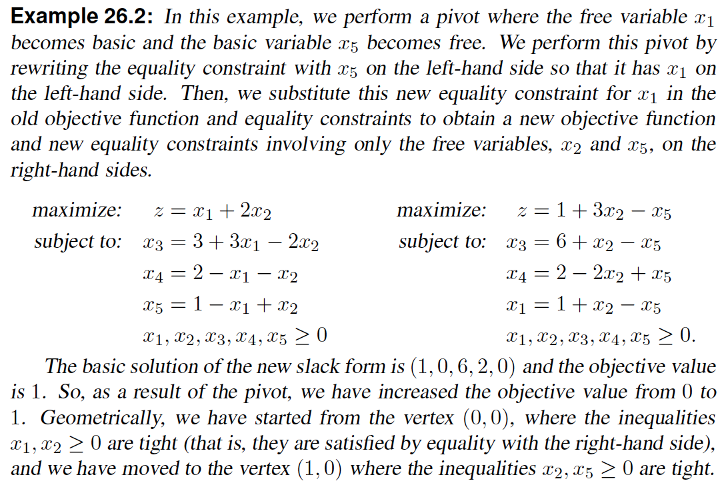
Example Pivot

Slide 12
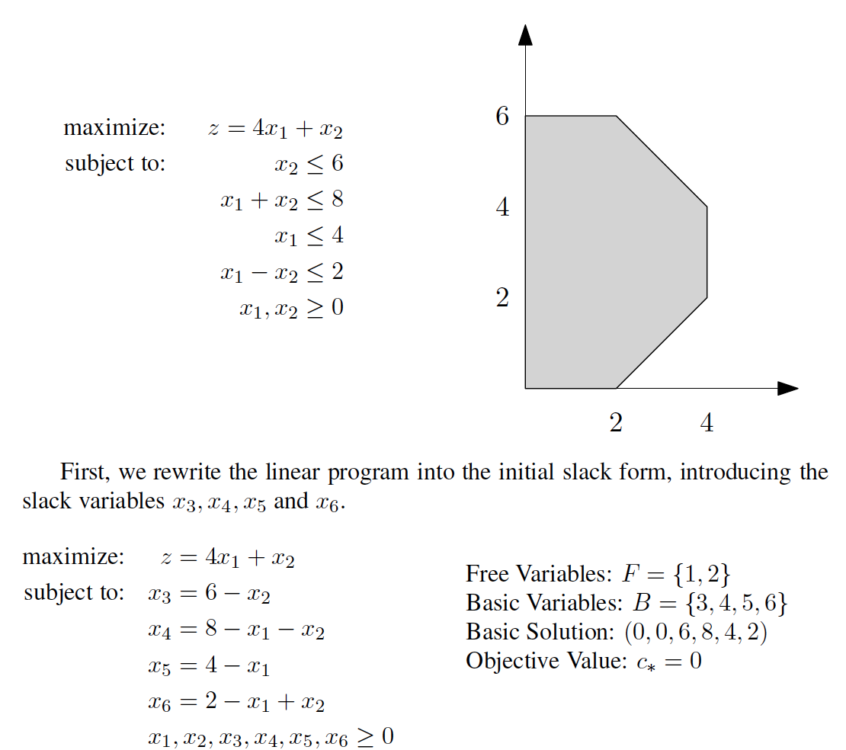
An Extended Example

Slide 13
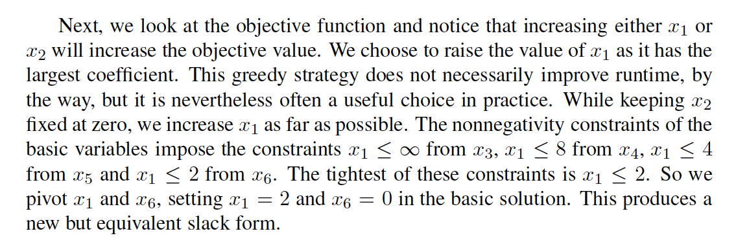
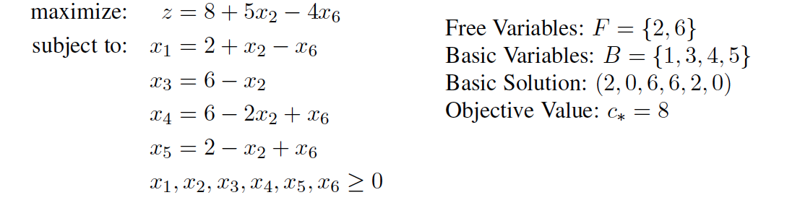
An Extended Example, step 2

Slide 14
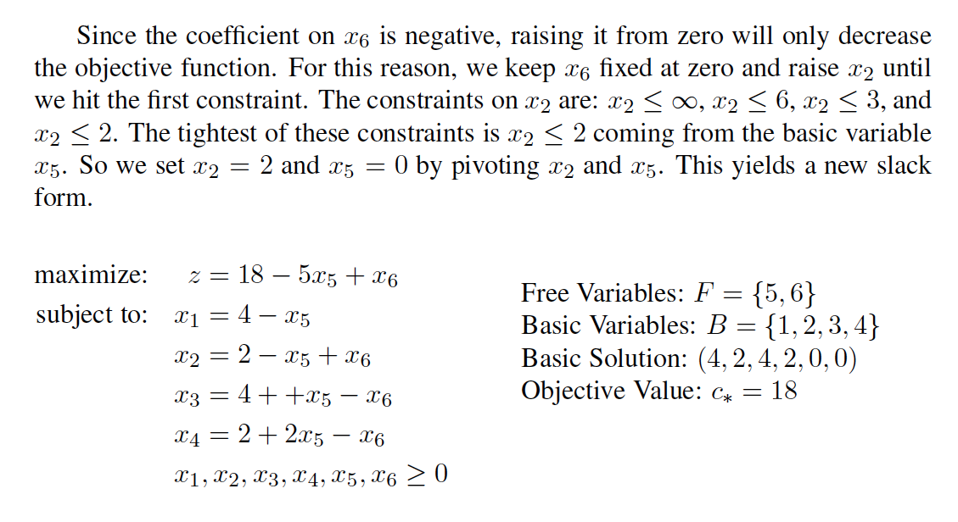
An Extended Example, step 3

Slide 15
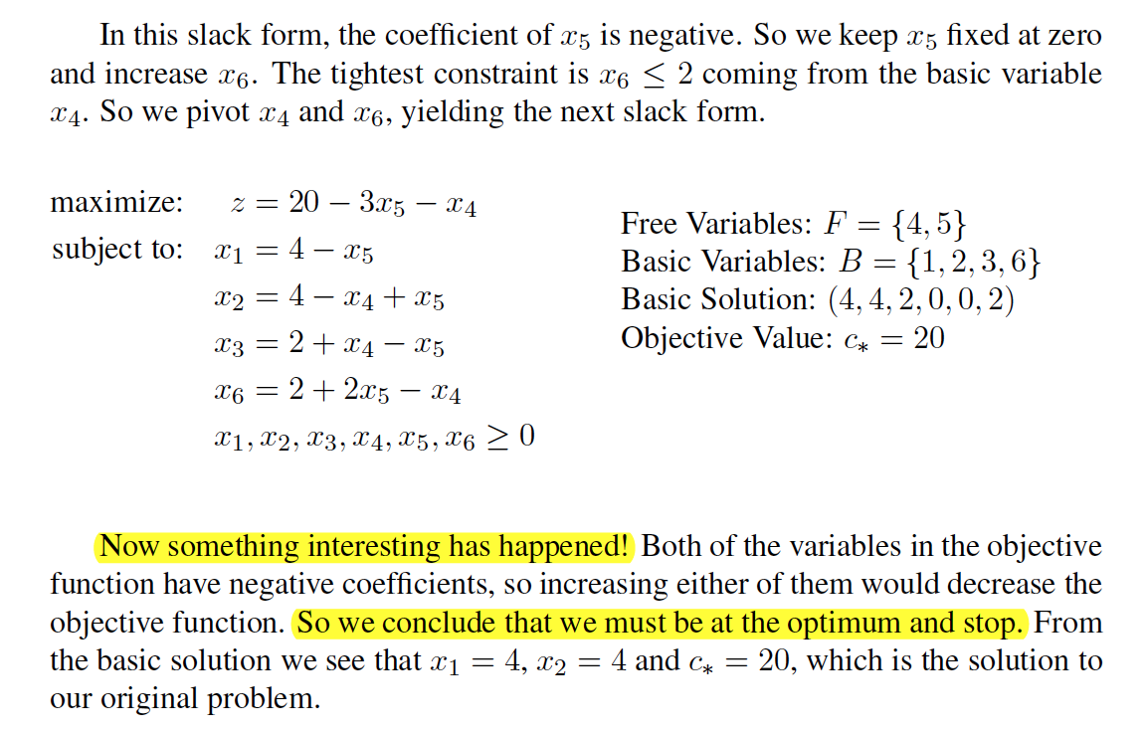
An Extended Example, step 4

Slide 16
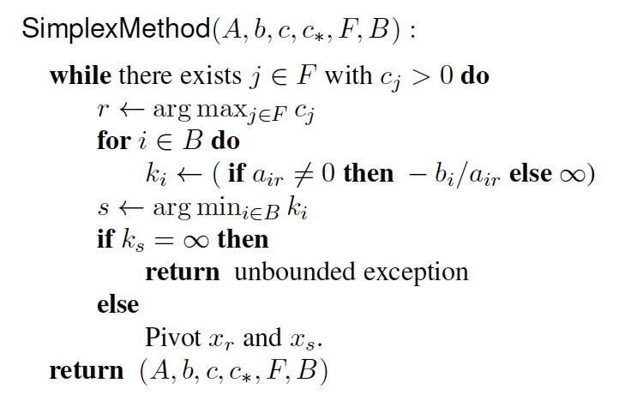
The Simplex Algorithm
We assume the input is given in slack form and that the basic solution is feasible.

Slide 17
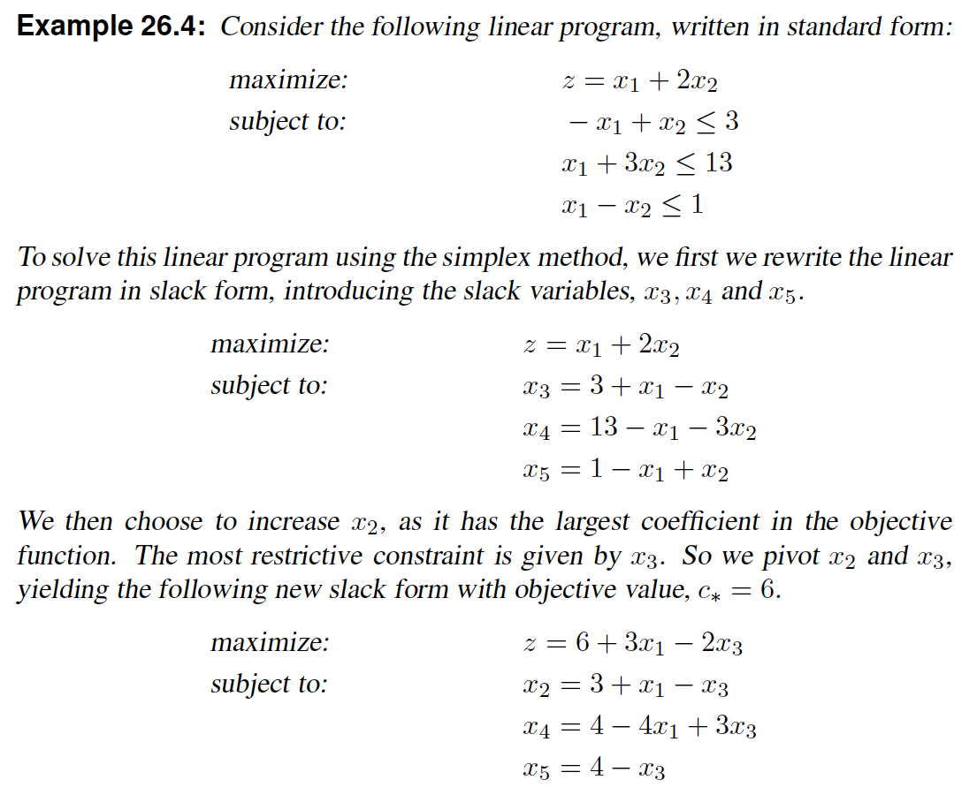
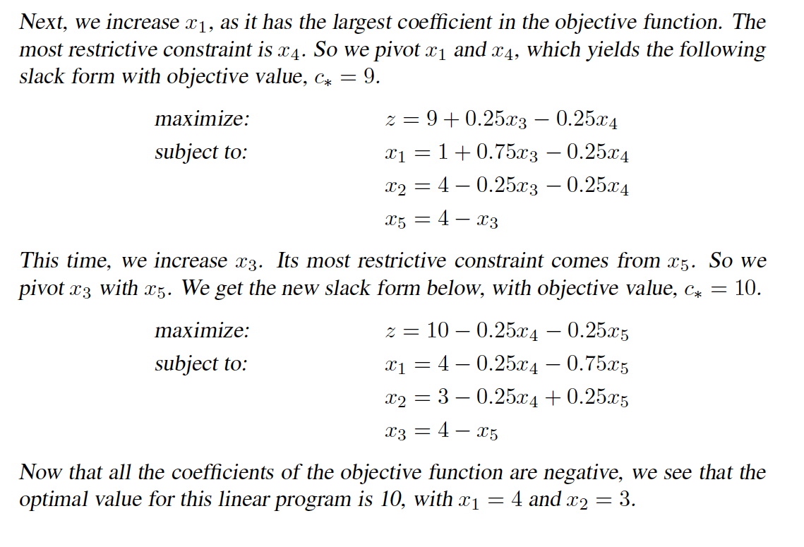
Another Simplex Example

Slide 18
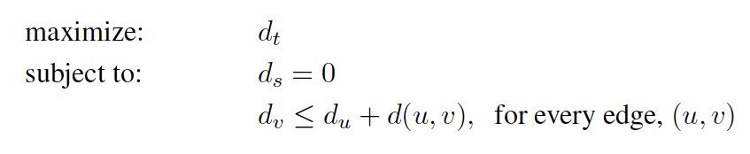
Application of Linear Programming to Shortest Paths
In the shortest-path problem, we have a source, s, and target, t, such that each edge, (u, v), has a weight, d(u, v), that represents the distance between two locations, u and v. The goal is to find the shortest path between the source, s, and target, t.
We can formulate a linear program for this problem based on the setup and termination conditions for the Bellman-Ford algorithm.
We define for every vertex, v, a variable, d_{v}, which should represent the shortest distance between s and v. The initialization, ds = 0, now becomes one of our constraints.
To pinpoint the correct value for d_{t}, we use the termination condition of the Bellman-Ford algorithm—namely, that the triangle inequality holds for every edge. We want d_{t} to be the largest value that satisfies these conditions. Thus, the corresponding linear program is the following:

